Slide 1
Implementation of Daily Pre-Exposure Prophylaxis (PrEP) for MSM and Trans Women:
A Demonstration Study in the Context of Combination HIV Prevention in Brazil, Mexico and Peru
Peru Component

Slide 2
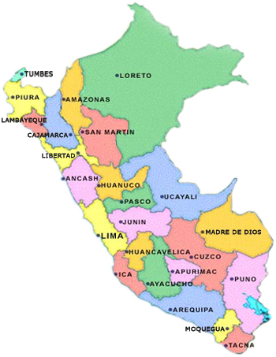
Study Design in Peru
Services:
9 Public (CERITS / UAMP)
1 Private in Lima (INMENSA)
Recruitment goal for follow-up: 1500
Recruitment: During 2018
Follow-up: 1.5-2.5 years (until June 2020)
1 MOH Hospital (Hospital Regional de Trujillo)
2 MOH Hospital (Hospital Amazónico)
1 MOH Hospital (Hospital La Caleta)
1 MOH Centers (San José, Barton, Tahuantinsuyo Bajo, Caja de Agua)
1 Private Center (Inmensa)
2 MOH Hospitals (Hospital Regional de Ica, Hospital San Juan Bautista)

Slide 3
Potential Benefits for the Country
Strengthening combination prevention strategy
Incorporation of new technologies and developing combined prevention
Greater potential to effectively address the HIV epidemic in MSM and Trans
Dissemination of PrEP for MSM and Trans
Identification of criteria for efficacious PrEP implementation
Programmatic
Education for health care providers
etc.

Slide 4
Implementation Issues in Peru

Slide 5
Networking and Coalition Building
We worked with the HIV Prevention in the MoH during study planning stages
Concerns regarding how to include PrEP within existing health services persist
Close communication during preparation, WHO / UNAIDS / PAHO endorsement and respect for formal processes provided legitimacy to the collaboration
At the organizational and implementation level: three key difficulties were observed:
Very frequent changes in authorities
Lack of interest in the improvement of HIV / STI health services
In some health providers, lack of interest due to absence of additional compensation
Most health facilities demonstrated willingness to collaborate and commitment; understanding ImPrEP as an opportunity to improve services

Slide 6
Community Engagement and Demand Creation
Formative research: Familiarity with the doubts, myths, and fears about PrEP among both gay and trans communities was fundamental
Additional strategies are needed for transwomen
Planning: coalition building and the development of effective coalitions was a critical strategy for project implementation
Preparation for implementation: Community representatives have accompanied the process
Including visiting CBOs near all research sites
Challenges included educating community representatives on PrEP
Work with CBOs must continue to develop critical agents to work toward improved quality of care to facilitate sustained demand for quality PrEP services

Slide 7
Health Systems and Preparedness
One significant challenge to PrEP inclusion in HIV/STI prevention services for HIV(-) individuals is staffing
These facilities have midwives and nurses, with physicians playing a part-time supervisory role
As only physicians can prescribe PrEP creative & ad hoc solutions have been needed
Laboratory staffing also varies widely
Some sites have 1 part time technician for all lab procedures (e.g. if this person is absent, no study visits are possible)
HIV prevention facilities have variable autonomy: some are within hospitals while others are independent
Backup equipment, lab QA/QC, & technical assistance are relatively easy in Lima, but not outside of Lima

Slide 8
Many Thanks!
Carlos F. Caceres
Kelika Konda, Juan V Guanira, Gino Calvo (Epidemiology, Clinical, and Coordination)
Ximena Salazar, Aron Núnez-Curto (Qual. Research)
Silver Vargas, Lourdes Ramos, Luz Jazmin Qquellon (Laboratory)
Elizabeth Lugo (Regulatory)
Miguel Lozano (IT)
Oliver Elorreaga (Data Management)
Ximena Gutiérrez, Sonia Flores (Administrative)
Fernando Olivos, Cecilia Ugaz (Communications)
Raul Almonte (Logistics)
Eduardo Juárez, Gaby Mariño (Community Liaison)

